Slide 1

Borland Valley Prescription
May 2018 Public Meeting
Photo credit: Stan Navratil
B.A. Blackwell & Associates Ltd.
Presenter: Bruce Blackwell

Slide 2
Fuel Management
What Fuel Management is:
  Fuel management focuses on reducing or controlling fire behaviour, and fire effects, and cost of suppression.
  Historically it was primarily concerned with fire protection.
  More recent recognition of the importance of fire as an ecological process has led to increased use of prescribed fire not only as a fire suppression tool but as an ecosystem restoration tool.
    It is useful in altering fire frequency and intensity.
Notes:
Fuel management’s aim is not to completely eliminate the risk of wildfire but to prevent it from occurring in certain locations and at catastrophic levels.
Give example of National Parks burning programs and how they have moved from an ideology of suppression to one recognizing the ecological role fire plays in natural ecosystems and using it as a tool to manage for human and ecological values and processes.

Slide 3
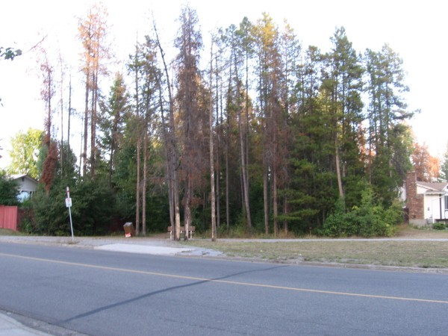
Fuel Management
  Why We Conduct Fuel Management:
  Multiple goals:
  Protect public health and safety or values at risk,
  Fire behaviour reduction,
  Forest health – treatment of pine beetle or killed forest adjacent to communities,
  Generate revenue – bio-energy Plants, or commercial thin,
  Ecosystem restoration.
Photo by B. A. Blackwell & Associates
Notes:
Although restoration is focused on dry forests, forestry practices on the coast are having effects upon the abundance of Douglas-fir. Historic logging has resulted in a reduction of Fd and Cw and the proliferation of Hw often with extensive Dwarf Mistletoe. Stanley Park and North Vancouver are good examples.
Pellet plants could change the revenue balance in fuel treatment projects, making them revenue positive in some cases.
Prince George has embarked upon extensive fuel reduction treatments – these address fire hazard, forest health and danger trees associated with trees killed by IBM

Slide 4
Fuel Management
  Where We Practice Fuel Management:
  1) Ecosystems appropriate for restoration
  2) Wildland Urban Interface (WUI)
  WUI is the interface between forest and communities.
    For example:
    Large cities with a matrix of vegetated areas,
    Communities surrounded by forest,
    Low density housing like remote homes (rural locations) or recreational property.
  3) High hazard fuel types adjacent to valuable or critical infrastructure.
Notes:
Due to high costs of fuel treatment up $20,000/ha, fuel treatments need to be strategically located to best maximize their effect.
Examples of Restoration Projects in B.C. Parks where prescribe burns are used to reduce fuels, control forest health, and positively impact biodiversity: Mt Robson Provincial Park, Mt Assiniboine Provincial Park
Fraser Grasslands on Crown land. Reducing encroachment through mechanical and prescribe burn methods
Community Wildfire Protection Planning and Fuel treatment Program for communities

Slide 5
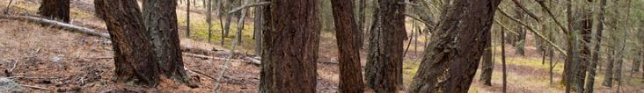
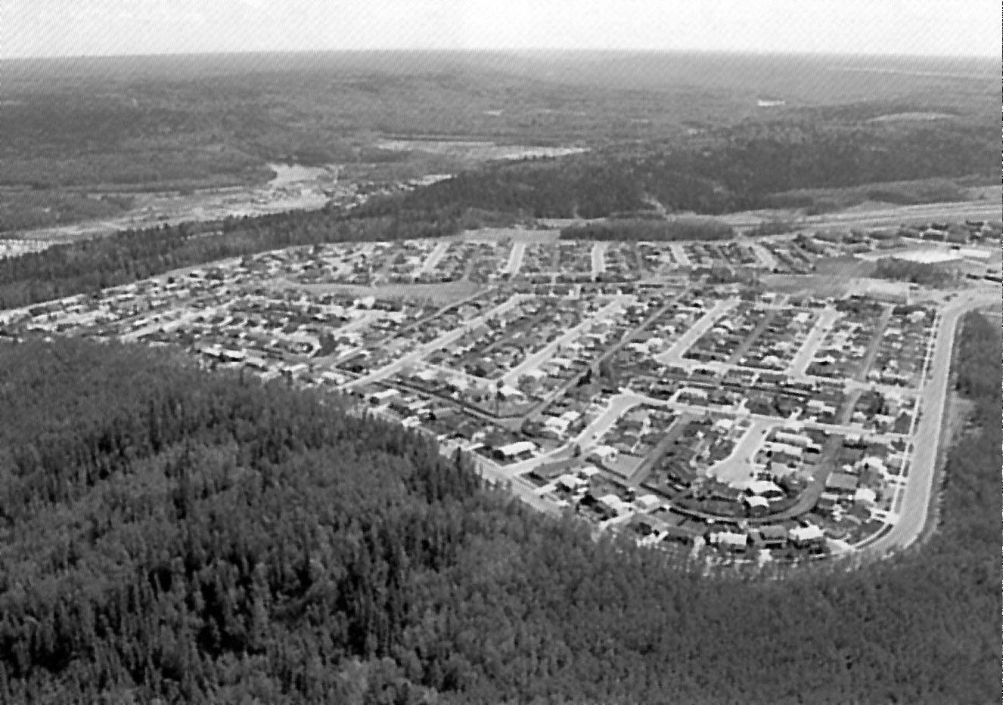
Interface Fire Issues
Interface Fire Issues
Interface defined…
“Forest meets Community”
Notes:
Interface Fire Issues Animated Slide
So… -What are we talking about when we say interface?
-How do we define interface?
At it’s simplest…
… it is that area where the ‘Forest meets the Community’
ADVANCE 2x
Or…
…any area where combustible wildland fuels are found adjacent homes, farm structures and other outbuildings.
ADVANCE

Slide 6
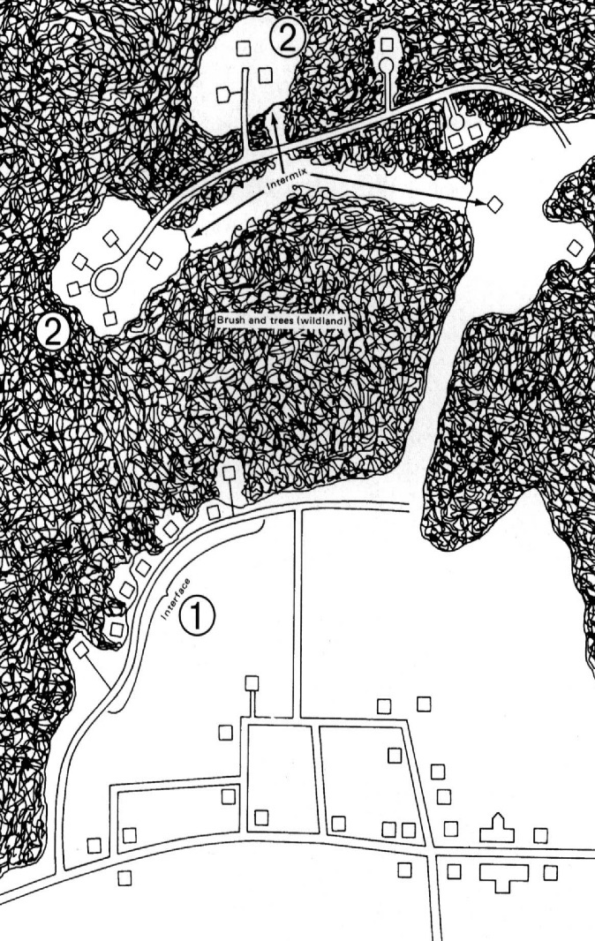
Interface Fire Issues
How does fire threaten the interface?
Wildland
Fire Threat…
Community
Notes:
How does fire threaten the interface? Animated Slide
The wildland/urban interface fire problem stems from two different sources of fire and their impact on the community.
Fires can move from…
ADVANCE 3x
Wildland (forest, bush or grassland) areas into the community
or…
ADVANCE

Slide 7
Interface Fire Issues
How does fire threaten the interface?
Wildland
Fire Threat…
Community
Notes:
How does fire threaten the interface? Animated Slide
Fires can move from…
ADVANCE
…the community into adjacent wildlands.
ADVANCE 2x
Fire spreading from communities can damage forests and threaten resource-based industries and parks.
ADVANCE

Slide 8
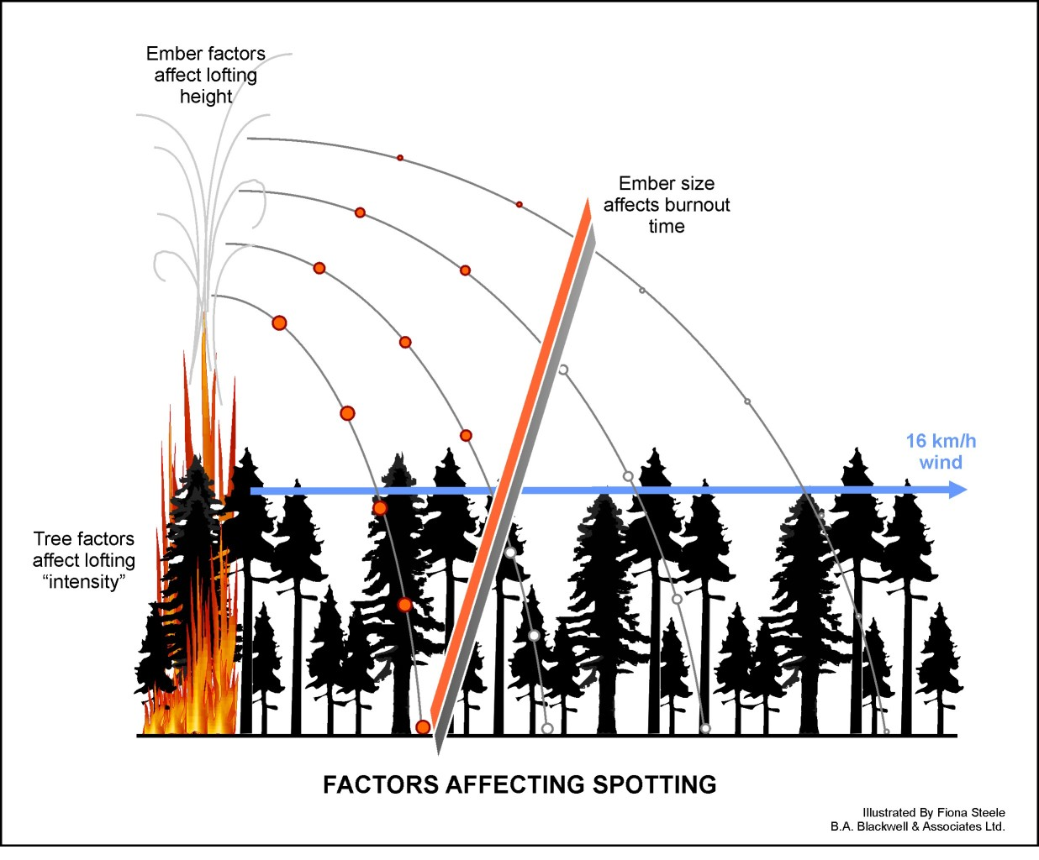
Fuel Treatments
Do Not Address Long Distance Spotting
Notes:
Moved to before the examples? Then you can show an e.g. of spotting

Slide 9
Fuel Management Prescription strategies
The prescription generally applies the following forestry activities to reduce wildfire hazard:
  Tree crown separation (tree thinning),
  Reduction of ladder fuels (tree pruning and tree thinning),
  Reduction of large, medium and fine fuels,
  Retention of tree species with lower flammability (deciduous), and
  Removal of danger and unhealthy trees.

Slide 10
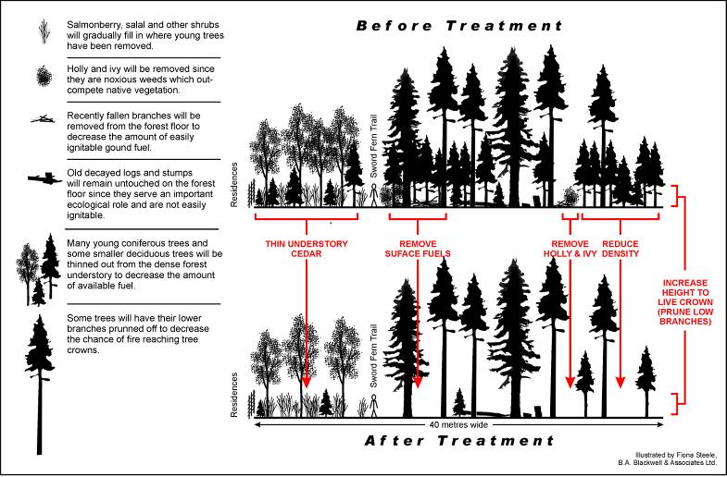
Vegetation management

Slide 11
Operation Fuel Treatment Planning
Prioritization and selection of treatment units for implementation,
Budgeting of costs of specific activities per hectare that are prescribed within the FMP,
    Methods for cost reduction may include: pile burning, merchantable timber sales, competitive tender process.
Application and approval by FESBC,
Public engagement before implementation.

Slide 12
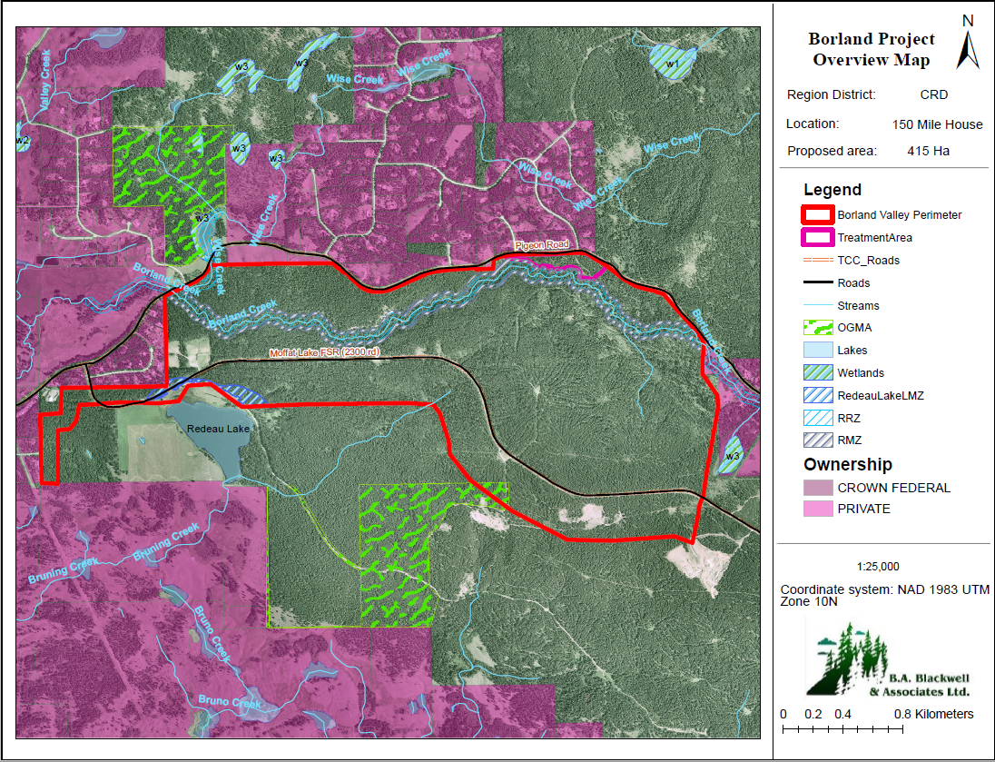

Slide 13
Analysis of Other Values
B.A. Blackwell & Associates Ltd.
The constraints analysis revealed several key considerations:
  Forest Management for Mule deer winter range (MDWR)
    Specifically related to basal area (BA) requirements for residual stands (≥12.5 cm dbh and ≥37.5 cm dbh)
  Management of existing recreational trails
  Old Growth Management Areas (OGMAs)
  Species at risk: Blue listed Bobolink
  Range tenures and Trapline licenses
  Archeological resources and cultural heritage

Slide 14
Forest Management Objectives
B.A. Blackwell & Associates Ltd.
WUI Threat Reduction (high to moderate)
  Thinning-from-below to attain a target residual stem count of 400 stems per hectare (sph). This approach will ensure crown separation, increase in height to live crown and a reduction in surface fuels. Protection of residential homes takes precedence here.
Mule Deer Habitat Restoration
  Target residual stem count (600 sph) was derived using considerations for BA requirements as dictated by the Government Actions Regulation (GAR) order and its corresponding General Wildlife Measures (GWMs). A thorough review of current literature and guideline documents regarding MDWR management was undertaken.
Primary Fuel Break
  The fundamental goal of this objective is to confine potential fires to the ground level and abstain them from crowning. Although a minimum of 100 m is required for a primary fuel break, a width of 300 m is recommended/more desirable. In this case, a vertical separation of the demonstration units is recommended within the primary fuel break (i.e., north to south).

Slide 15
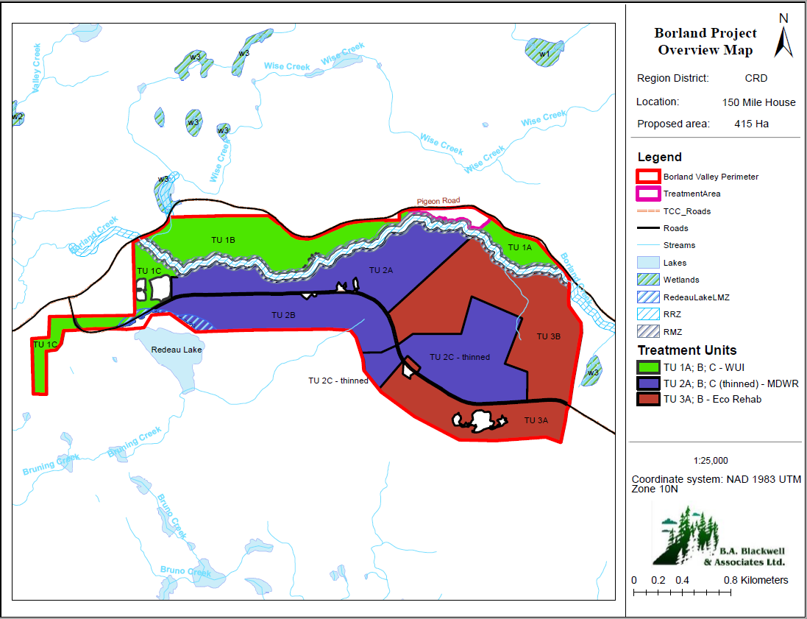
Option #1
WUI
Mule Deer Habitat Restoration
Ecosystem Rehabilitation

Slide 16
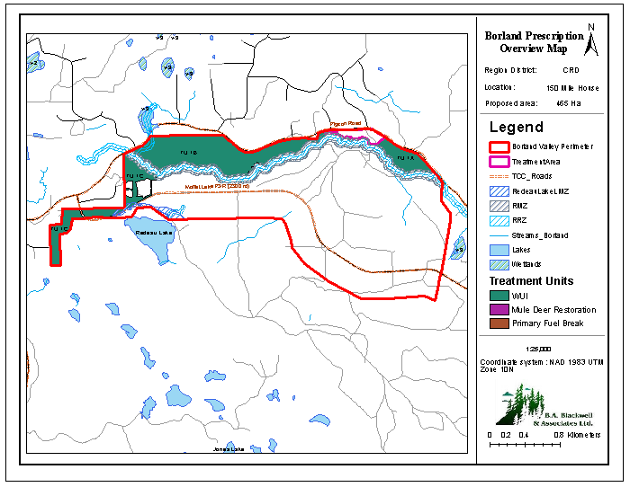
WUI Treatment Units
B.A. Blackwell & Associates Ltd.

Slide 17
WUI Treatment Units
B.A. Blackwell & Associates Ltd.
Treatment Units identified in this category:
TU 1A (Pigeon East), TU 1B (Pigeon West), and TU 1C (Redeau Finger)
TU1 A and B are to be managed under moderate stand structure objectives for Mule Deer Winter Range, while TU1C is to be managed under high stand structure objectives.
Principles and Objectives for Classification
  Primary consideration:
    Prioritization of fire threat reduction in units closest to residential homes ( fire threat)
  Secondary considerations:
    Mule Deer Habitat Restoration ( short-term, but long-term)
    Ecosystem rehabilitation ( - neutral)
    Timber supply ( long-term)

Slide 18
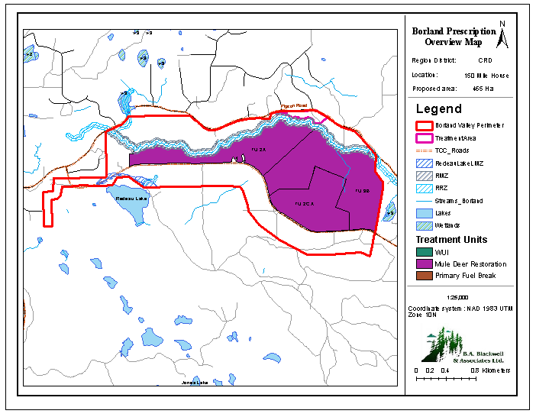
Mule Deer Habitat Restoration Units
B.A. Blackwell & Associates Ltd.

Slide 19
Mule Deer Habitat Restoration Units
B.A. Blackwell & Associates Ltd.
Treatment Units identified in this category:
TU 2A (Redeau North), TU 3B (Redeau East Loop), and TU 2C A (Redeau Central North).
These units are to be managed for high stand structure objectives for Mule Deer Winter Range.
Principles and Objectives for Classification
  Primary considerations:
    Mule deer Habitat Restoration ( long-term)
    Fire threat – WUI Reduction ( )
  Secondary considerations:
    Ecosystem rehabilitation ( - neutral)
    Timber supply ( - neutral)

Slide 20
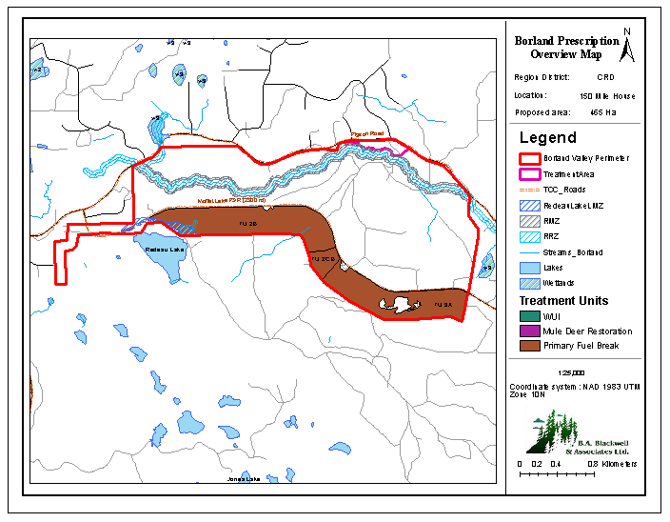
Primary Fuel Break Units
B.A. Blackwell & Associates Ltd.

Slide 21
Primary Fuel Break Units
B.A. Blackwell & Associates Ltd.
Treatment Units identified in this category:
TU 2B (Redeau South Central), TU 2C B (Redeau Central), and TU 3A (Redeau Southeast).
These units are to be managed for high stand structure objectives for Mule Deer Winter Range.
Principles and Objectives for Classification
  Primary considerations:
    Fire threat – Reduction ( )
  Secondary considerations:
    Mule Deer Habitat Restoration ( long-term)
    Timber supply ( - neutral)

Slide 22
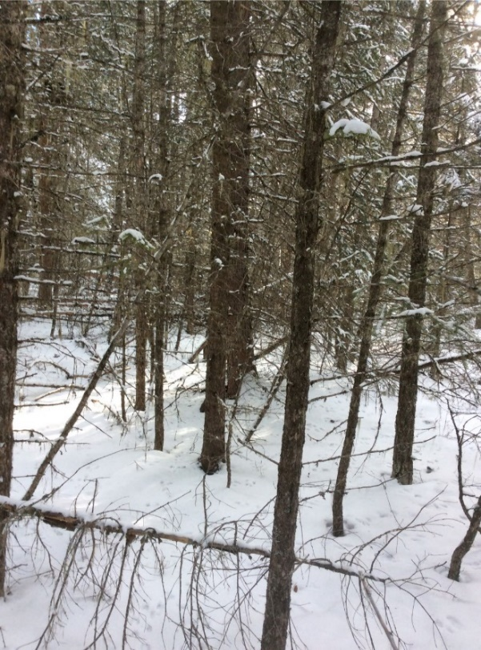
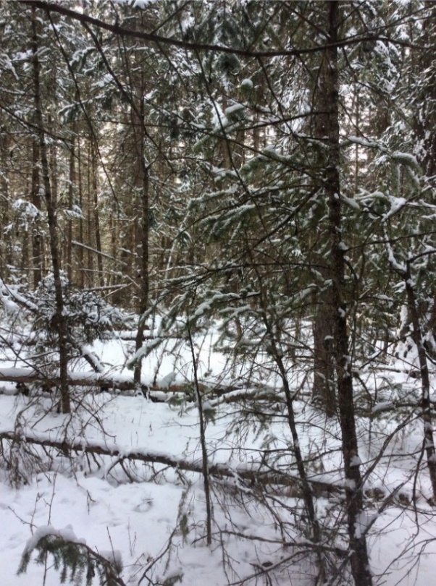
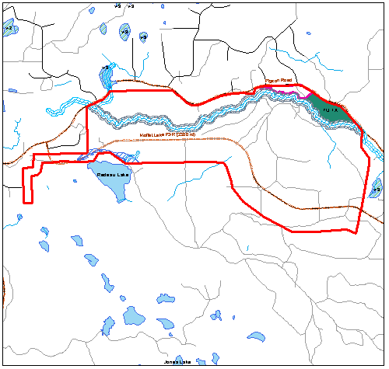
Treatment Unit 1A – Pigeon East
B.A. Blackwell & Associates Ltd.
Treatment Unit | Name | Fuel Type | Stand Age (years) | Wildfire Behaviour Threat Class |  | Merch Basal Area (m²/ha) |  | Merch Volume (m³/ha) |  | Total Stems per hectare (sph)
 |  |  |  | Pre -Treatment | Post -Treatment | Pre -Treatment | Post -Treatment | Pre -Treatment | Post -Treatment | Pre -Treatment | Post -Treatment
TU 1A | Pigeon East | C3/M2 | 130-150 | High | Moderate | 23 | 21 | 196 | 182 | 2450 | 400
TU 1A
Figure 1. Representative photos for TU 1A.

Slide 23
Treatment Unit 1A – Pigeon East
B.A. Blackwell & Associates Ltd.
TU 1A - Merch Stems/ha
Residual BA = 22 m2/ha, D.lim = 60 cm, q=1.25 vs. q=1.35
Figure 2. Target stand versus prescribed stand for TU 1A.

Slide 24
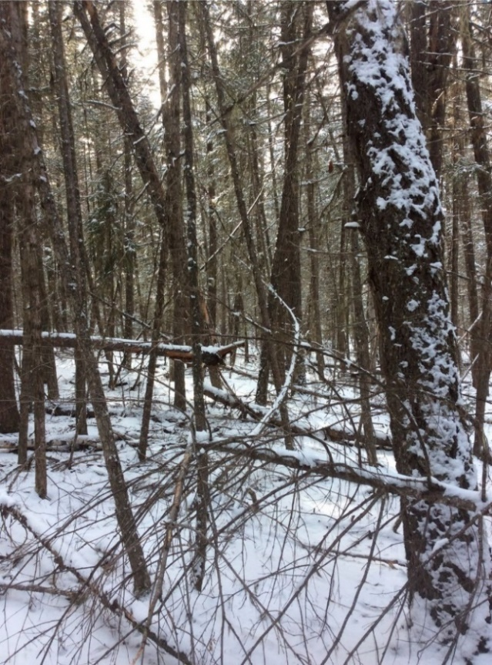
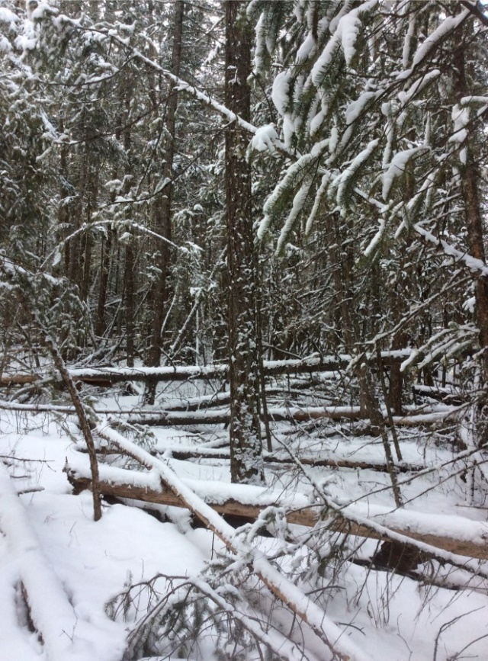
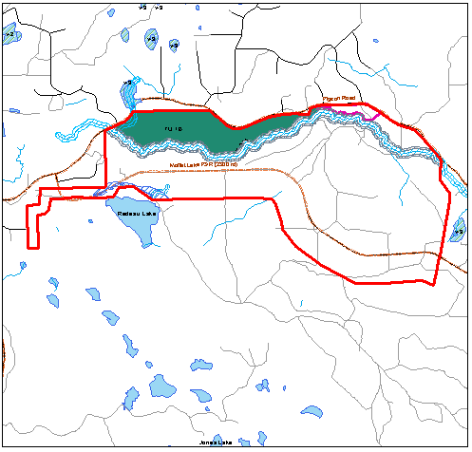
Treatment Unit 1B – Pigeon West
B.A. Blackwell & Associates Ltd.
Treatment Unit | Name | Fuel Type | Stand Age (years) | Wildfire Behaviour Threat Class |  | Merch Basal Area (m²/ha) |  | Merch Volume (m³/ha) |  | Total Stems per hectare (sph)
 |  |  |  | Pre -Treatment | Post -Treatment | Pre -Treatment | Post -Treatment | Pre -Treatment | Post-Treatment | Pre -Treatment | Post -Treatment
TU 1B | Pigeon West | C3 | 130-150 | High | Moderate | 47 | 24 | 327 | 166 | 2801 | 400
TU 1B
Figure 3. Representative photos for Treatment Unit (TU) 1B.

Slide 25
Treatment Unit 1B – Pigeon West
B.A. Blackwell & Associates Ltd.
Figure 4. Target stand versus prescribed stand for TU 1B.

Slide 26
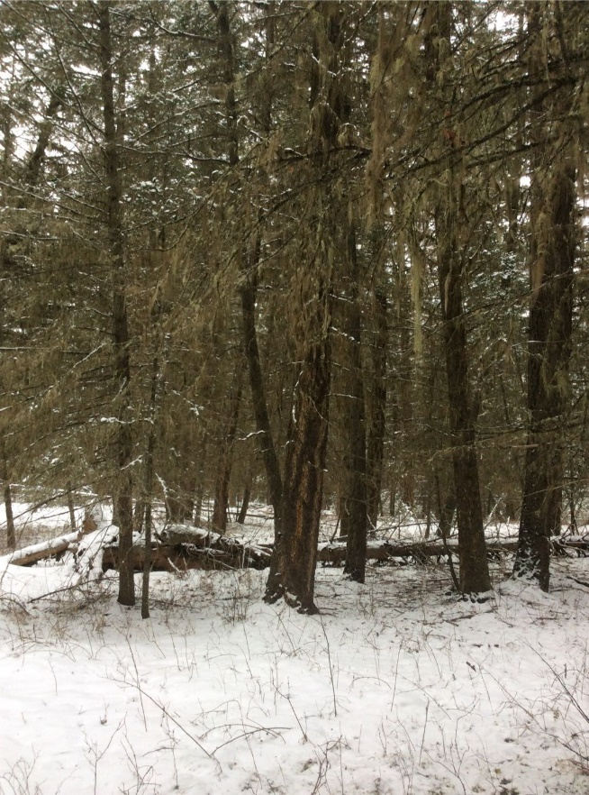
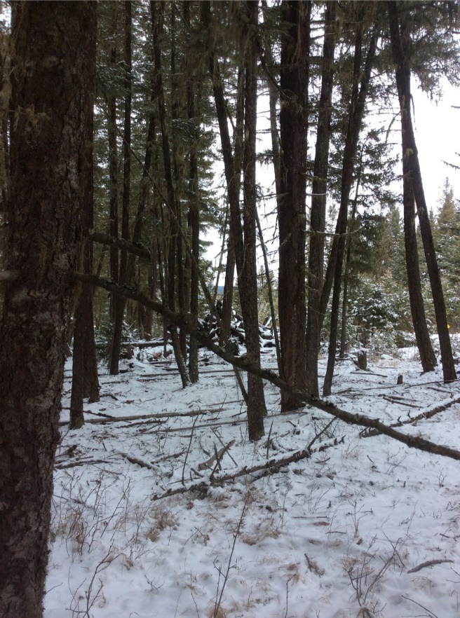
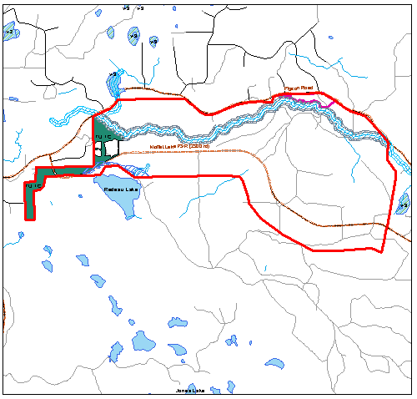
Treatment Unit 1C – Redeau Finger
B.A. Blackwell & Associates Ltd.
Treatment Unit | Name | Fuel Type | Stand Age (years) | Wildfire Behaviour Threat Class |  | Merch Basal Area (m²/ha) |  | Merch Volume (m³/ha) |  | Total Stems per hectare (sph)
 |  |  |  | Pre -Treatment | Post -Treatment | Pre -Treatment | Post -Treatment | Pre -Treatment | Post -Treatment | Pre -Treatment | Post -Treatment
TU 1C | Redeau Finger | C7 | 100-115 | High | Moderate | 50 | 36 | 368 | 263 | 3709 | 400
TU 1C
Figure 5. Representative photos for Treatment Unit 1C.

Slide 27
Treatment Unit 1C – Redeau Finger
B.A. Blackwell & Associates Ltd.
TU 1C - Merch Stems/ha
Residual BA = 29 m2/ha, D.lim = 70 cm, q=1.20 vs 1.35
Figure 6. Target stand versus prescribed stand for TU 1C.

Slide 28
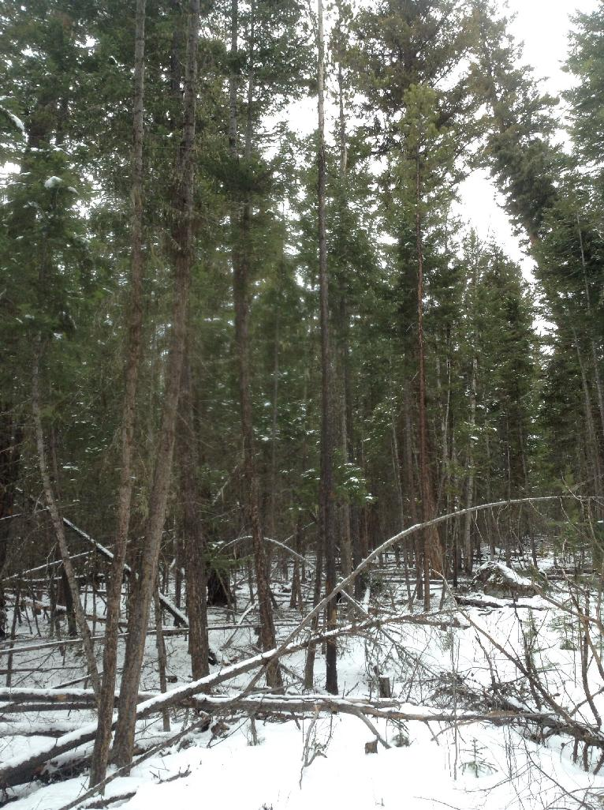
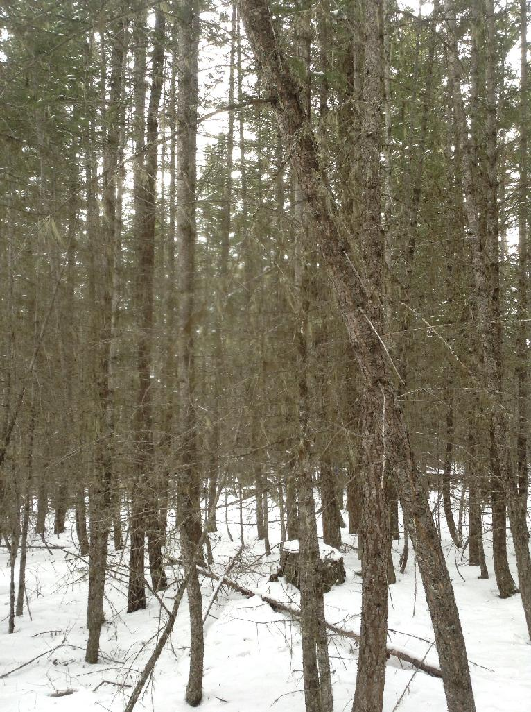
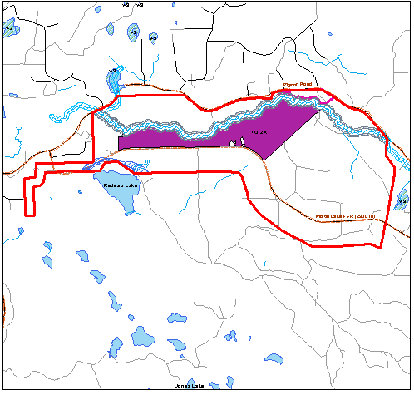
Treatment Unit 2A – Redeau North
B.A. Blackwell & Associates Ltd.
Treatment Unit | Name | Fuel Type | Stand Age (years) | Wildfire Behaviour Threat Class |  | Merch Basal Area (m²/ha) |  | Merch Volume (m³/ha) |  | Total Stems per hectare (sph)
 |  |  |  | Pre-Treatment | Post-Treatment | Pre-Treatment | Post-Treatment | Pre-Treatment | Post-Treatment | Pre-Treatment | Post-Treatment
TU 2A | Redeau North | C3 | 60 (East) - 110 (West) | High | Moderate | 23 | 23 | 164 | 164 | 4542 | 600
TU 2A
Figure 7. Representative photos for Treatment Unit (TU) 2A.

Slide 29
Treatment Unit 2A – Redeau North
B.A. Blackwell & Associates Ltd.
TU 2A - Merch Stems/ha
Residual BA = 29 m2/ha, D.lim = 70 cm, q=1.20 vs 1.35
Figure 8. Target stand versus prescribed stand for TU 2A.

Slide 30
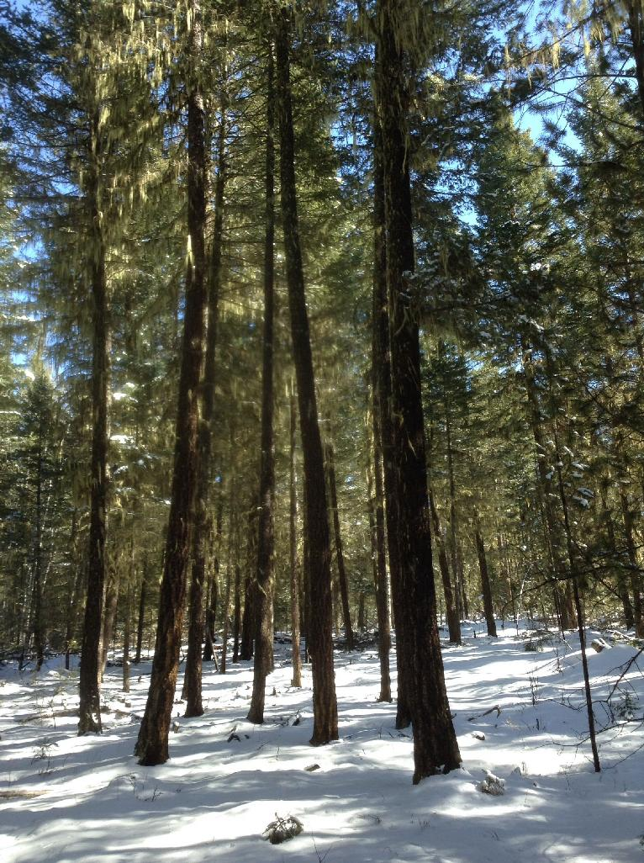
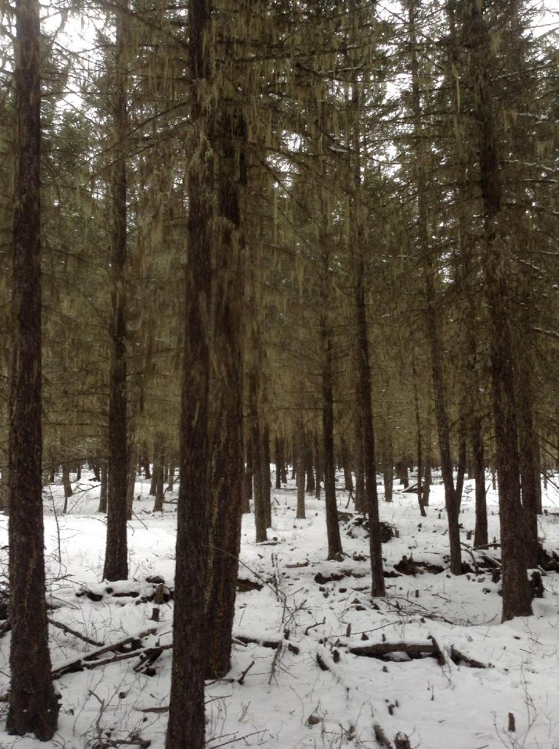
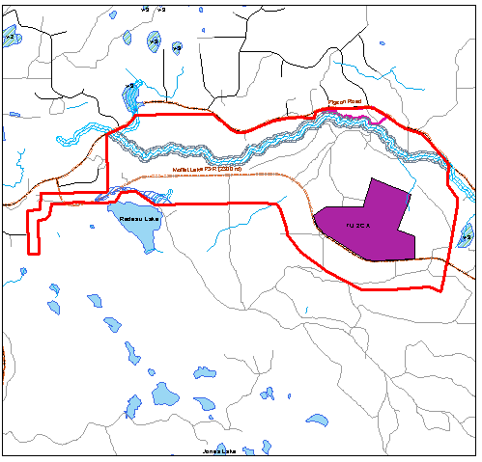
Treatment Unit 2C A – Redeau Central North
B.A. Blackwell & Associates Ltd.
Treatment Unit | Name | Fuel Type | Stand Age (years) | Wildfire Behaviour Threat Class |  | Merch Basal Area (m²/ha) |  | Merch Volume (m³/ha) |  | Total Stems per hectare (sph)
 |  |  |  | Pre-Treatment | Post-Treatment | Pre-Treatment | Post-Treatment | Pre-Treatment | Post-Treatment | Pre-Treatment | Post-Treatment
TU 2C A | Redeau Central North | C7 - thinned | 100-130 | High | Moderate | 23 | 20 | 117 | 101 | 2811 | 600
Figure 11. Representative photos for Treatment Unit (TU) 2C A.
TU 2C A

Slide 31
Treatment Unit 2C A – Redeau Central North
B.A. Blackwell & Associates Ltd.
TU 2C A - Merch Stems/ha
Residual BA = 29 m2/ha, D.lim = 70 cm, q=1.2 vs. q=1.35
Figure 12. Target stand versus prescribed stand for TU 2C A.

Slide 32
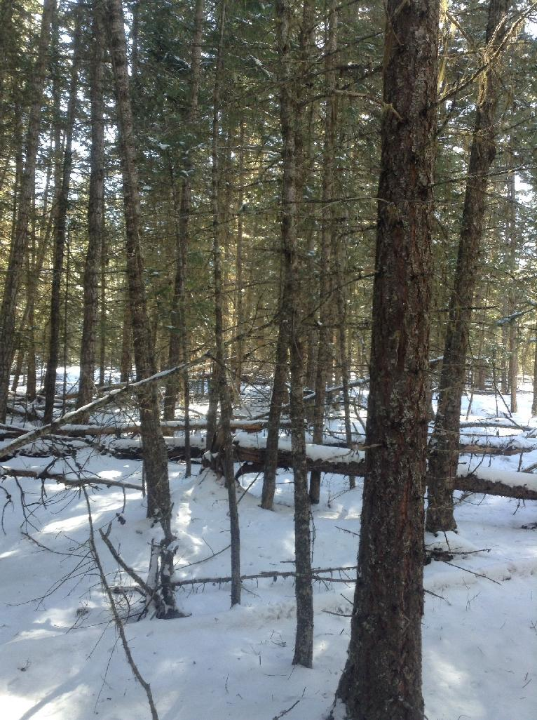
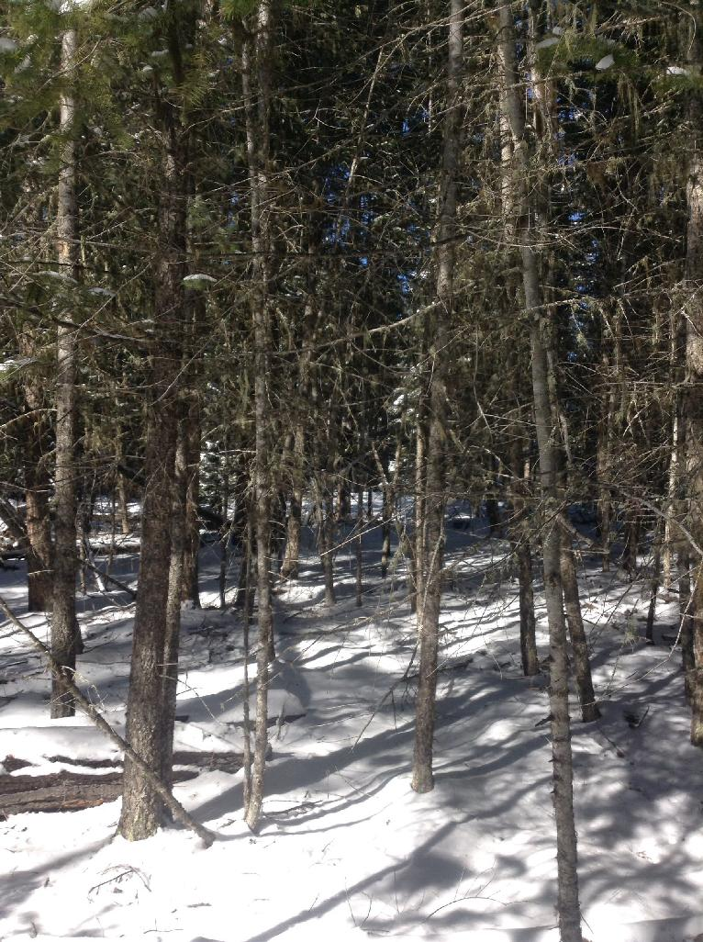
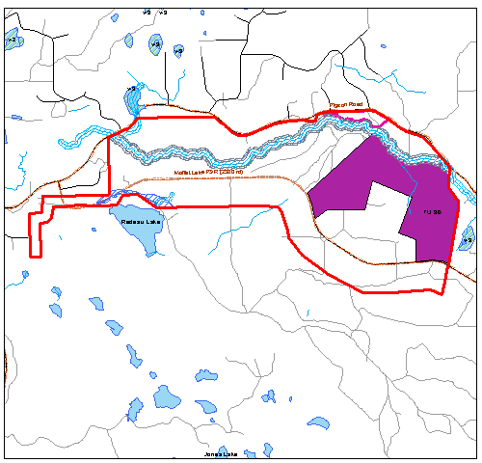
Treatment Unit 3B – Redeau East Loop
B.A. Blackwell & Associates Ltd.
Treatment Unit | Name | Fuel Type | Stand Age (years) | Wildfire Behaviour Threat Class |  | Merch Basal Area (m²/ha) |  | Merch Volume (m³/ha) |  | Total Stems per hectare (sph)
 |  |  |  | Pre-Treatment | Post-Treatment | Pre-Treatment | Post-Treatment | Pre-Treatment | Post-Treatment | Pre-Treatment | Post-Treatment
TU 3B | Redeau East Loop | C3 | 115-140 | High | Moderate | 22 | 15 | 131 | 91 | 3354 | 600
TU 3B
Figure 15. Representative photos for Treatment Unit (TU) 3B.

Slide 33
Treatment Unit 3B – Redeau East Loop
B.A. Blackwell & Associates Ltd.
TU 3B - Merch Stems/ha
Residual BA = 29 m2/ha, D.lim = 70 cm, q=1.2 vs q=1.35
Figure 16. Target stand versus prescribed stand for TU 3B.

Slide 34
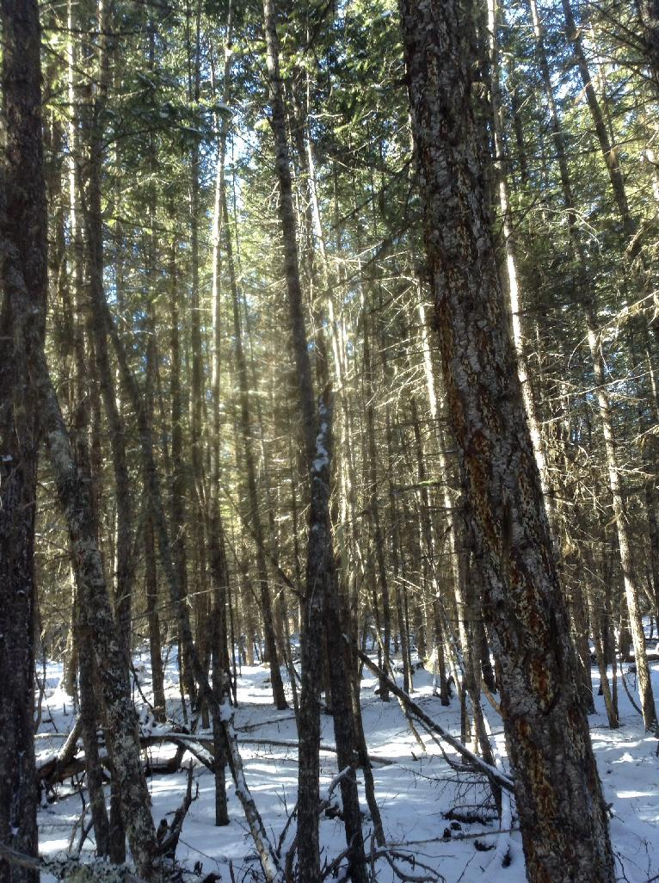
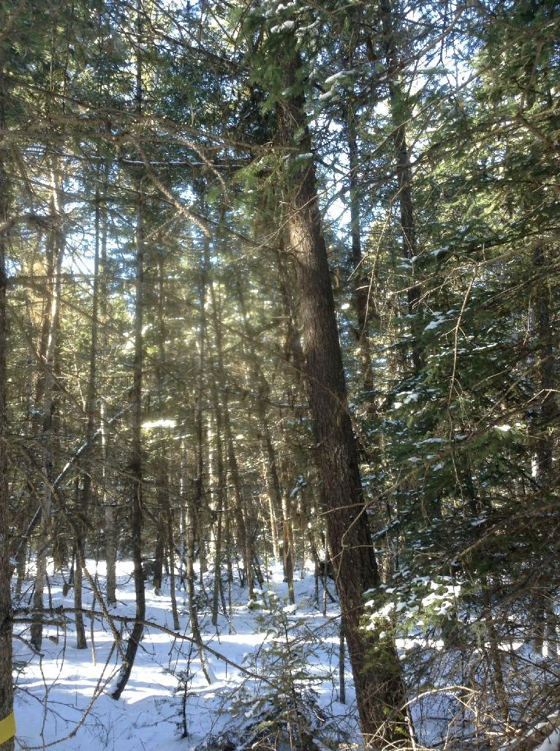
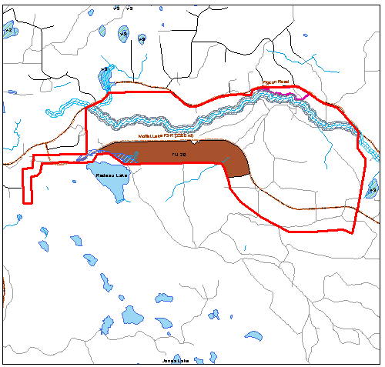
Treatment Unit 2B – Redeau South Central
B.A. Blackwell & Associates Ltd.
Treatment Unit | Name | Fuel Type | Stand Age (years) | Wildfire Behaviour Threat Class |  | Merch Basal Area (m²/ha) |  | Merch Volume (m³/ha) |  | Total Stems per hectare (sph)
 |  |  |  | Pre-Treatment | Post-Treatment | Pre-Treatment | Post-Treatment | Pre-Treatment | Post-Treatment | Pre-Treatment | Post-Treatment
TU 2B | Redeau South Central | C3/C7 | 110 (West) - 150 (East) | High | Moderate | 33 | 20 | 259 | 158 | 3421 | 400
TU 2B
Figure 9. Representative photos for Treatment Unit (TU) 2B.

Slide 35
Treatment Unit 2B – Redeau South Central
B.A. Blackwell & Associates Ltd.
TU 2B - Merch Stems/ha
Residual BA = 29 m2/ha, D.lim = 70 cm, q=1.20 vs 1.35
Figure 10. Target stand versus prescribed stand for TU 2B.

Slide 36
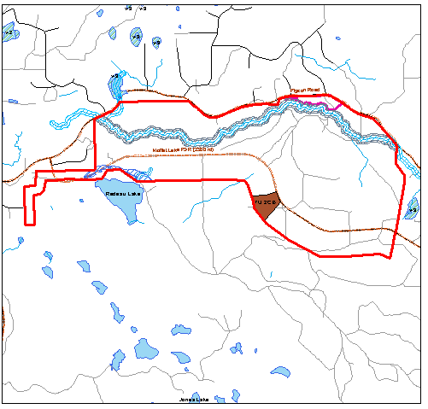
Treatment Unit 2C B – Redeau Central
B.A. Blackwell & Associates Ltd.
Treatment Unit | Name | Fuel Type | Stand Age (years) | Wildfire Behaviour Threat Class |  | Merch Basal Area (m²/ha) |  | Merch Volume (m³/ha) |  | Total Stems per hectare (sph)
 |  |  |  | Pre-Treatment | Post-Treatment | Pre-Treatment | Post-Treatment | Pre-Treatment | Post-Treatment | Pre-Treatment | Post-Treatment
TU 2C B | Redeau Central | C7 - thinned | 100-130 | High | Moderate | 40 | 34 | 245 | 211 | 3054 | 600
TU 2C B
Figure 11. Representative photos for Treatment Unit (TU) 2C B.

Slide 37
Treatment Unit 2C B– Redeau Central
B.A. Blackwell & Associates Ltd.
TU 2C B - Merch Stems/ha
Residual BA = 29 m2/ha, D.lim = 70 cm, q=1.2 vs. q=1.35
Figure 12. Target stand versus prescribed stand for TU 2C B.

Slide 38
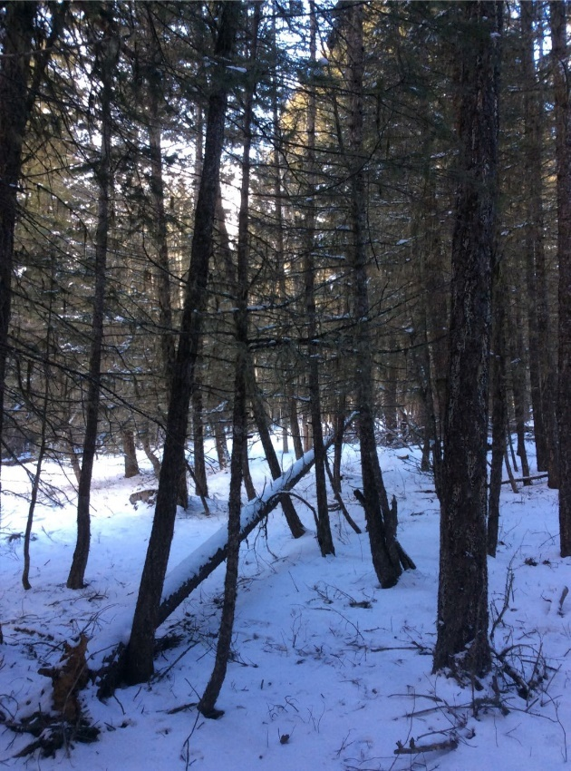
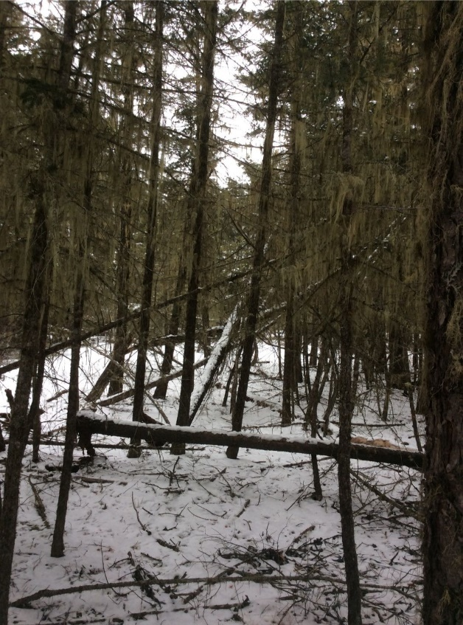
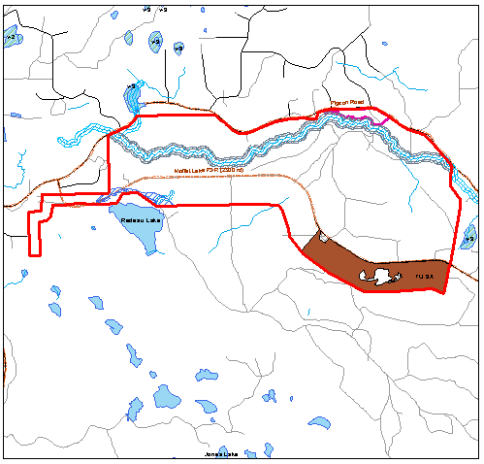
Treatment Unit 3A – Redeau Southeast
B.A. Blackwell & Associates Ltd.
Treatment Unit | Name | Fuel Type | Stand Age (years) | Wildfire Behaviour Threat Class |  | Merch Basal Area (m²/ha) |  | Merch Volume (m³/ha) |  | Total Stems per hectare (sph)
 |  |  |  | Pre-Treatment | Post-Treatment | Pre-Treatment | Post-Treatment | Pre-Treatment | Post-Treatment | Pre-Treatment | Post-Treatment
TU 3A | Redeau Southeast | C3 | 80 | High | Moderate | 13 | 9 | 62 | 44 | 4420 | 500
TU 3A
Figure 13. Representative photos for Treatment Unit (TU) 3A.

Slide 39
Treatment Unit 3A – Redeau Southeast
B.A. Blackwell & Associates Ltd.
Figure 14. Target stand versus prescribed stand for TU 3A.

Slide 40
Thank you!
Questions?
www.for.gov.bc.ca/ftp/DCC/external/publish/Borland Mitigation and Wildlife Enhancement Project/

